Slide 1
Heart of Knowledge
Weeks 3/4 Progress Update
Code-Blooded
Sammy Jones, Michael Schriefer, Zachary Mcnay, Peyton Hayes

Slide 2
Overview for Weeks 3/4
Wrote 252 Lines of Code
567 Lines in Total
Total Burndown Rate: 30.9%
10 Requirements Fulfilled (Burndown 34%)
19/28 Fulfilled
Total Burndown: 68%
5 Tests Completed (Burndown 7%)
12/69 Completed
Total Burndown: 17%

Slide 3
Updates 1
Feature 1 - Dark Mode (Burndown: 46%)
0 Lines of Code this week - 125 Lines total
0 Requirements fulfilled this week - 3/3 Requirements Fulfilled
0 Tests Completed this week - 3/10 Tests Completed
Feature 2 - Custom Templates For Pages (Burndown: 0%)
40 Lines of Code this week - 55 Lines total
0 Requirements fulfilled this week - 0/3 Requirements Fulfilled
0 Tests Completed this week - 0/10 Tests Completed
Feature 3 - User Default Template (Burndown: 0%)
0 Lines of Code this week - 0 Lines total
0 Requirements fulfilled this week - 0/3 Requirements
0 Tests Completed this week - 0/10 Tests Completed

Slide 4
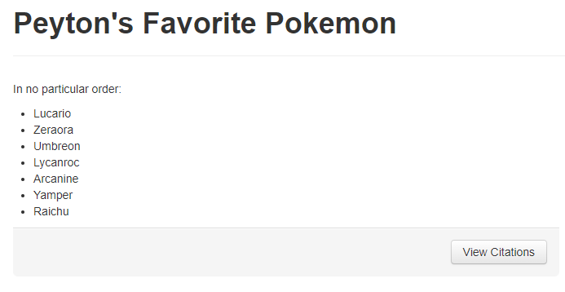
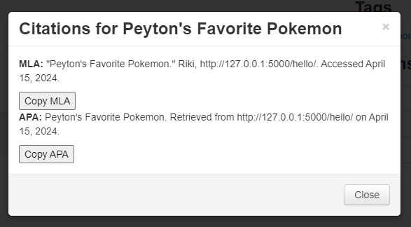
Updates 2
Feature 4 - Visibility/Accessibility Modifier (Burndown: 29%)
6 Lines of Code this week - 68 Lines total
1 Requirement fulfilled this week - 5/5 Requirements Fulfilled
0 Tests Completed this week - 0/12 Tests Completed
Feature 5 - Citation Generator (Burndown: 35%)
46 Lines of Code this week - 46 Lines total
7 Requirements fulfilled this week - 7/7 Requirements Fulfilled
0 Tests Completed this week - 0/13 Tests Completed

Slide 5
Updates 3
Feature 6 - Instructions / Tutorial Page (Burndown: 89%)
0 Lines of Code this week - 107 Lines total
0 Requirements fulfilled this week - 2/3 Requirements Fulfilled
2 Tests Completed this week - 6/6 Tests Completed total
Feature 7 - Table of Contents / User Privilege (Burndown: 36%)
160 Lines of Code this week - 160 Lines total
2 Requirements fulfilled this week - 2/4 Requirements Fulfilled
3 Tests Completed this week - 3/10 Tests Completed

Slide 6


